Slide 1

November 22, 2023
Machine Learning techniques applied to neutrinos recognition
- Selection of track events in KM3NeT/ORCA-
Louis Lovat
Mathieu Lamoureux
Gwenhaël de Wasseige

Slide 2
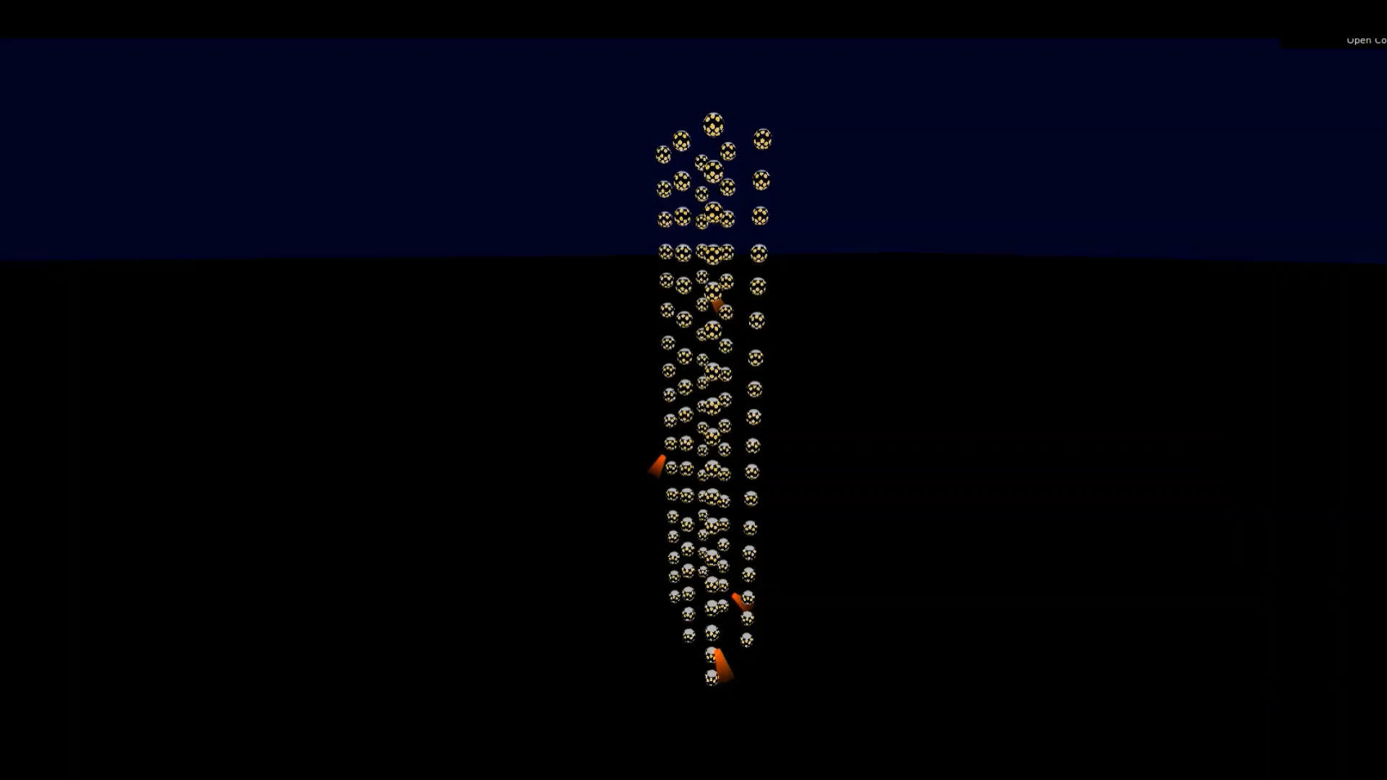
Exposition
KM3NeT : Neutrino detection through Cherenkov effect
Detector Unit
Digital Optical Module
(31 photomultiplier tubes)

Slide 3
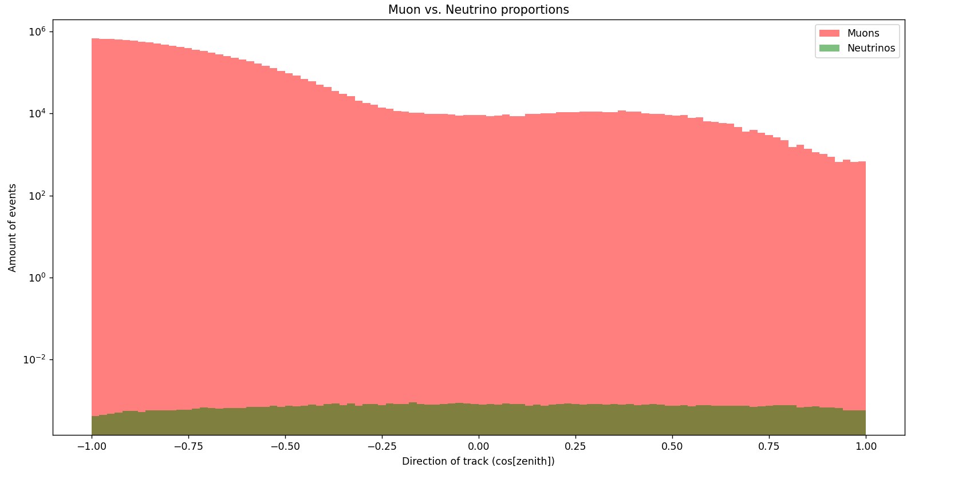
Problem statement
Overwhelming number of atmospheric muons
7 to 9 orders of magnitude

Slide 4
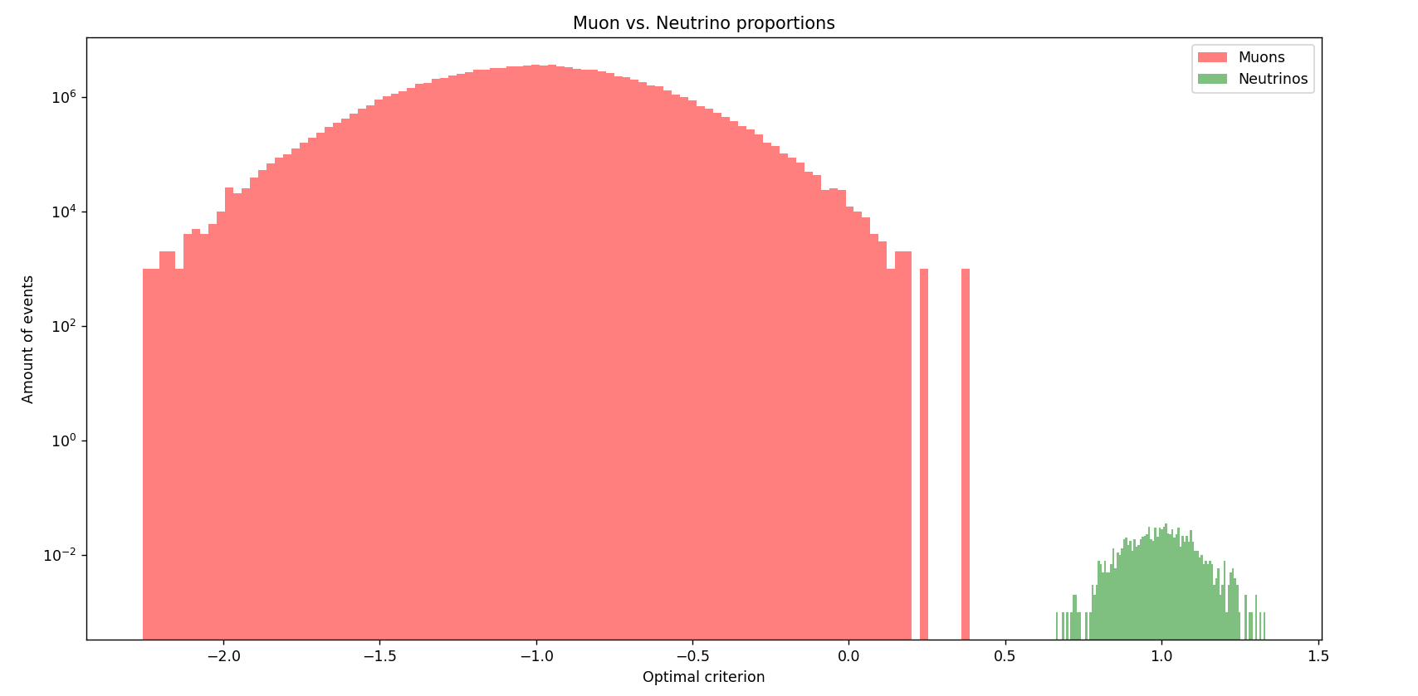
Objective
Finding a criterion for which the signal to noise ratio increases
Ideally

Slide 5
Method
Monte-Carlo simulations
Feature extrapolation from raw data :
Energy of particles
Repartition of photons in detector
Geometry of the track
…
Selection of a model

Slide 6
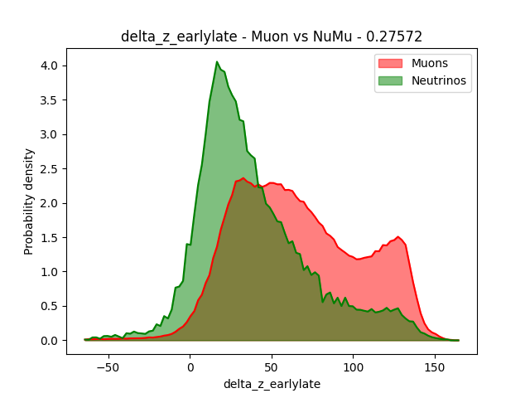
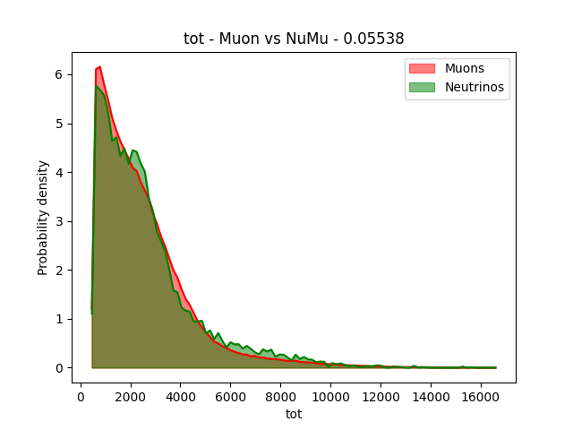
Method
Features : some examples

Slide 7
Method
Model selection : A simple model first
Optimizing the covariance between an ideal feature and the target feature : the type of the event (muon or neutrino)
Linear combination of features

Slide 8
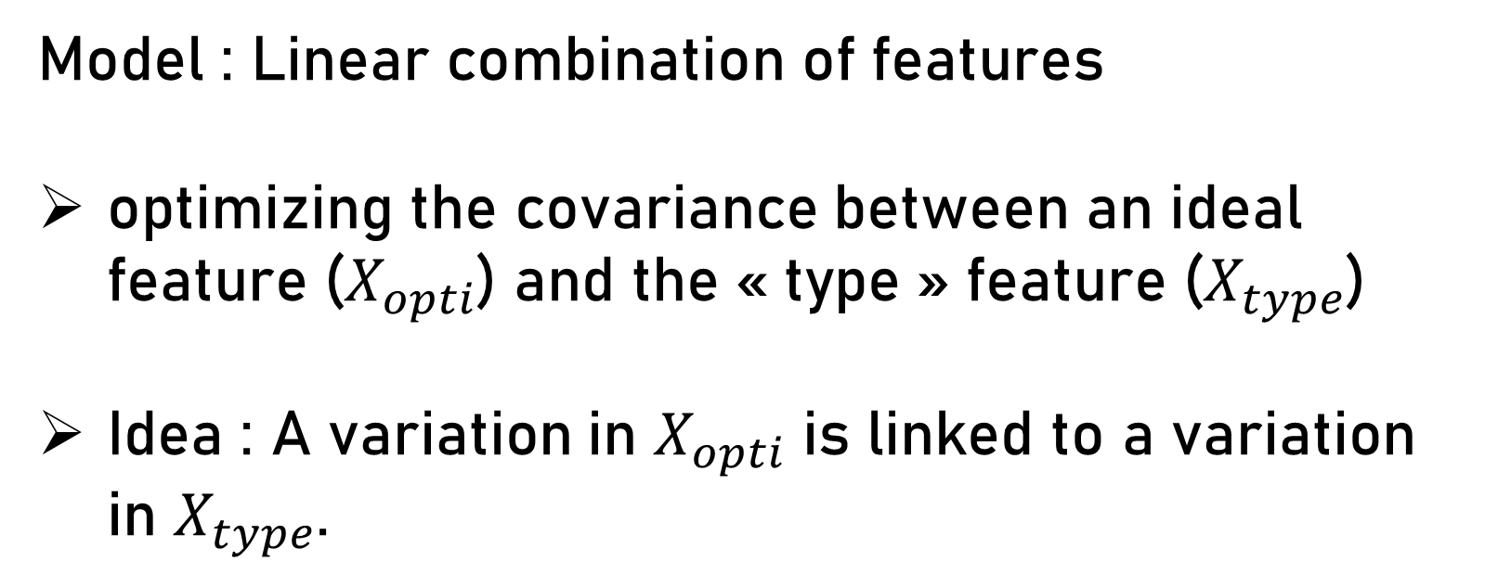
Method
Model : Linear combination of features
optimizing the covariance between an ideal feature ($X_{opti}$) and the « type » feature ($X_{type}$)
Idea : A variation in $X_{opti}$ is linked to a variation in $X_{type}$.

Slide 9
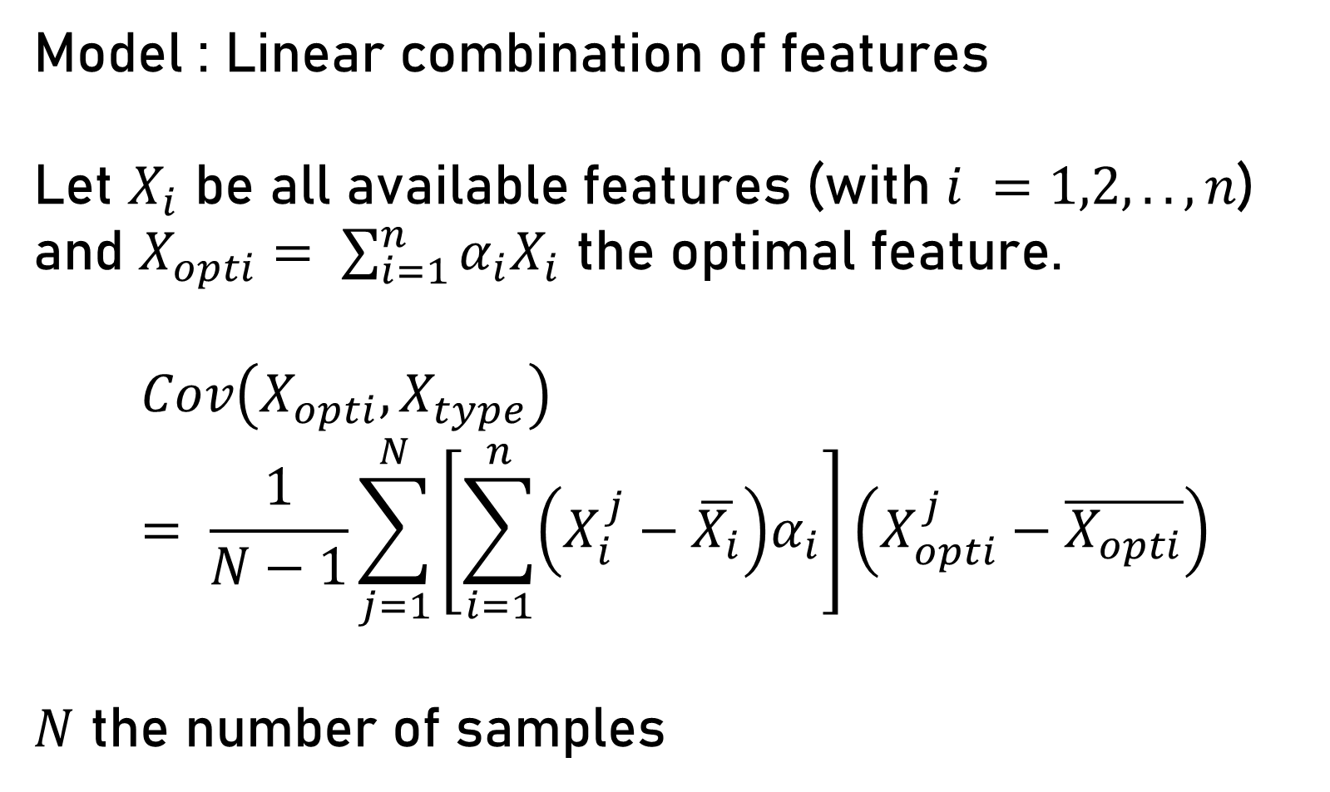
Method
Model : Linear combination of features
Let $X_{i}$ be all available features (with $i =1,2,..,n$) and $X_{opti}= \sum_{i=1}^{n}{α_{i}X_{i}}$ the optimal feature.
$$Cov\left(X_{opti}, X_{type}\right)= \frac{1}{N−1}\sum_{j=1}^{N}{\left[\sum_{i=1}^{n}{\left(X_{i}^{j}−\overline{X_{i}}\right)α_{i}}\right]\left(X_{opti}^{j}−\overline{X_{opti}}\right)}$$
$N$ the number of samples

Slide 10
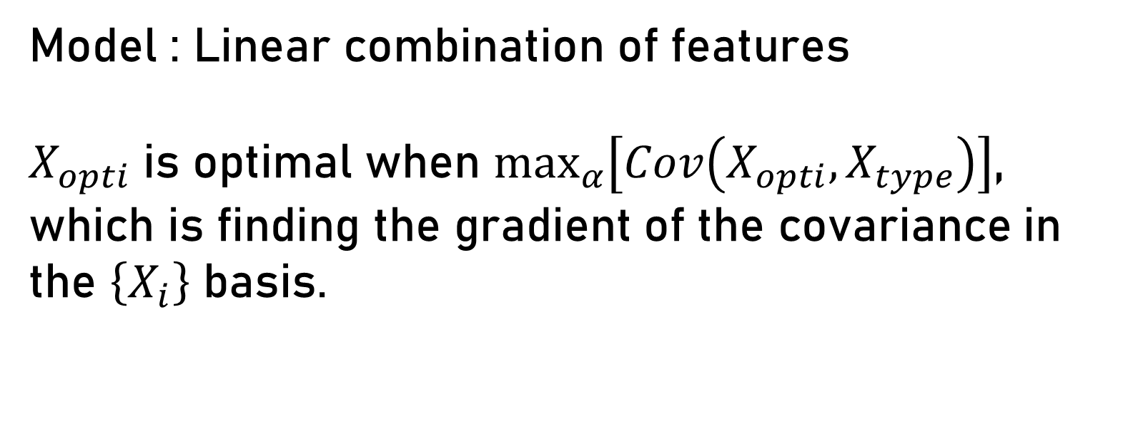
Method
Model : Linear combination of features
$X_{opti}$ is optimal when $\max_{α}\left[Cov\left(X_{opti}, X_{type}\right)\right]$, which is finding the gradient of the covariance in the $\left\{X_{i}\right\}$ basis.

Slide 11
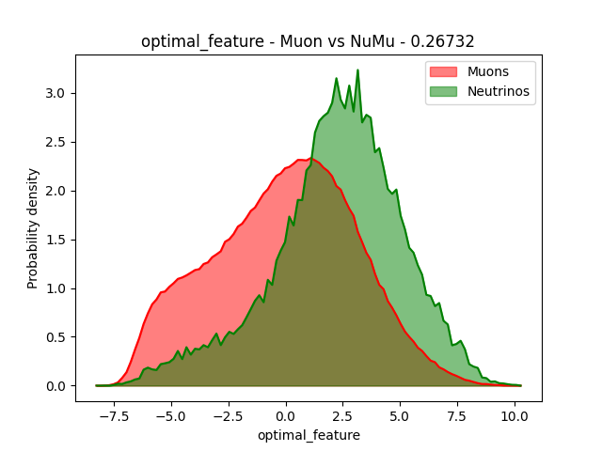
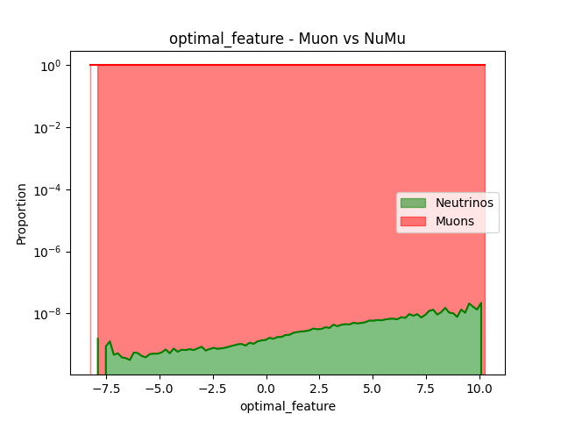
Method
Model : Linear combination of features
Result :
… A linear combination is not enough

Slide 12
Method
More complex models are needed :
Boosted Decision Trees
Neural Networks
Kernel Support Vector Machine
These need a dimensionality reduction
Feature selection

Slide 13
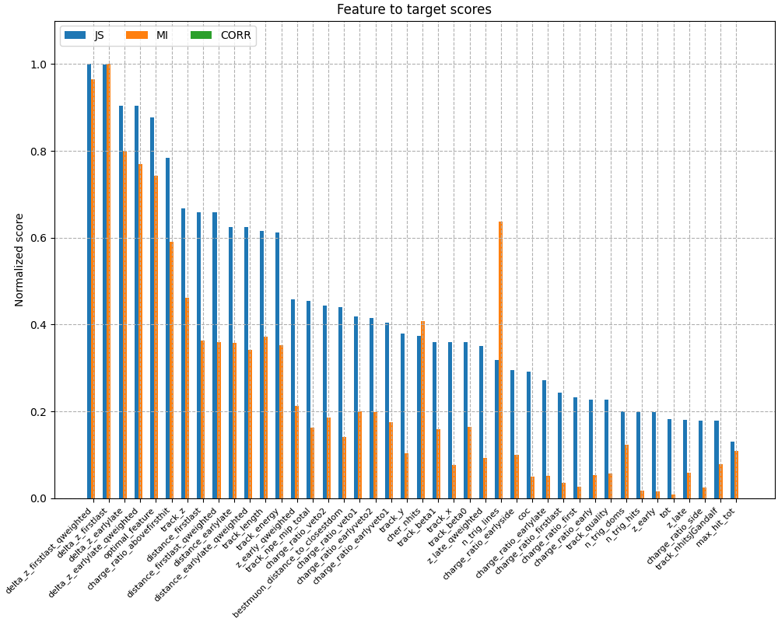
Method
Feature selection : Rating
Scores :
Linear relationship with the target (Correlation)
Non linear relationship with the target (Mutual Information and Jensen-Shanon)

Slide 14
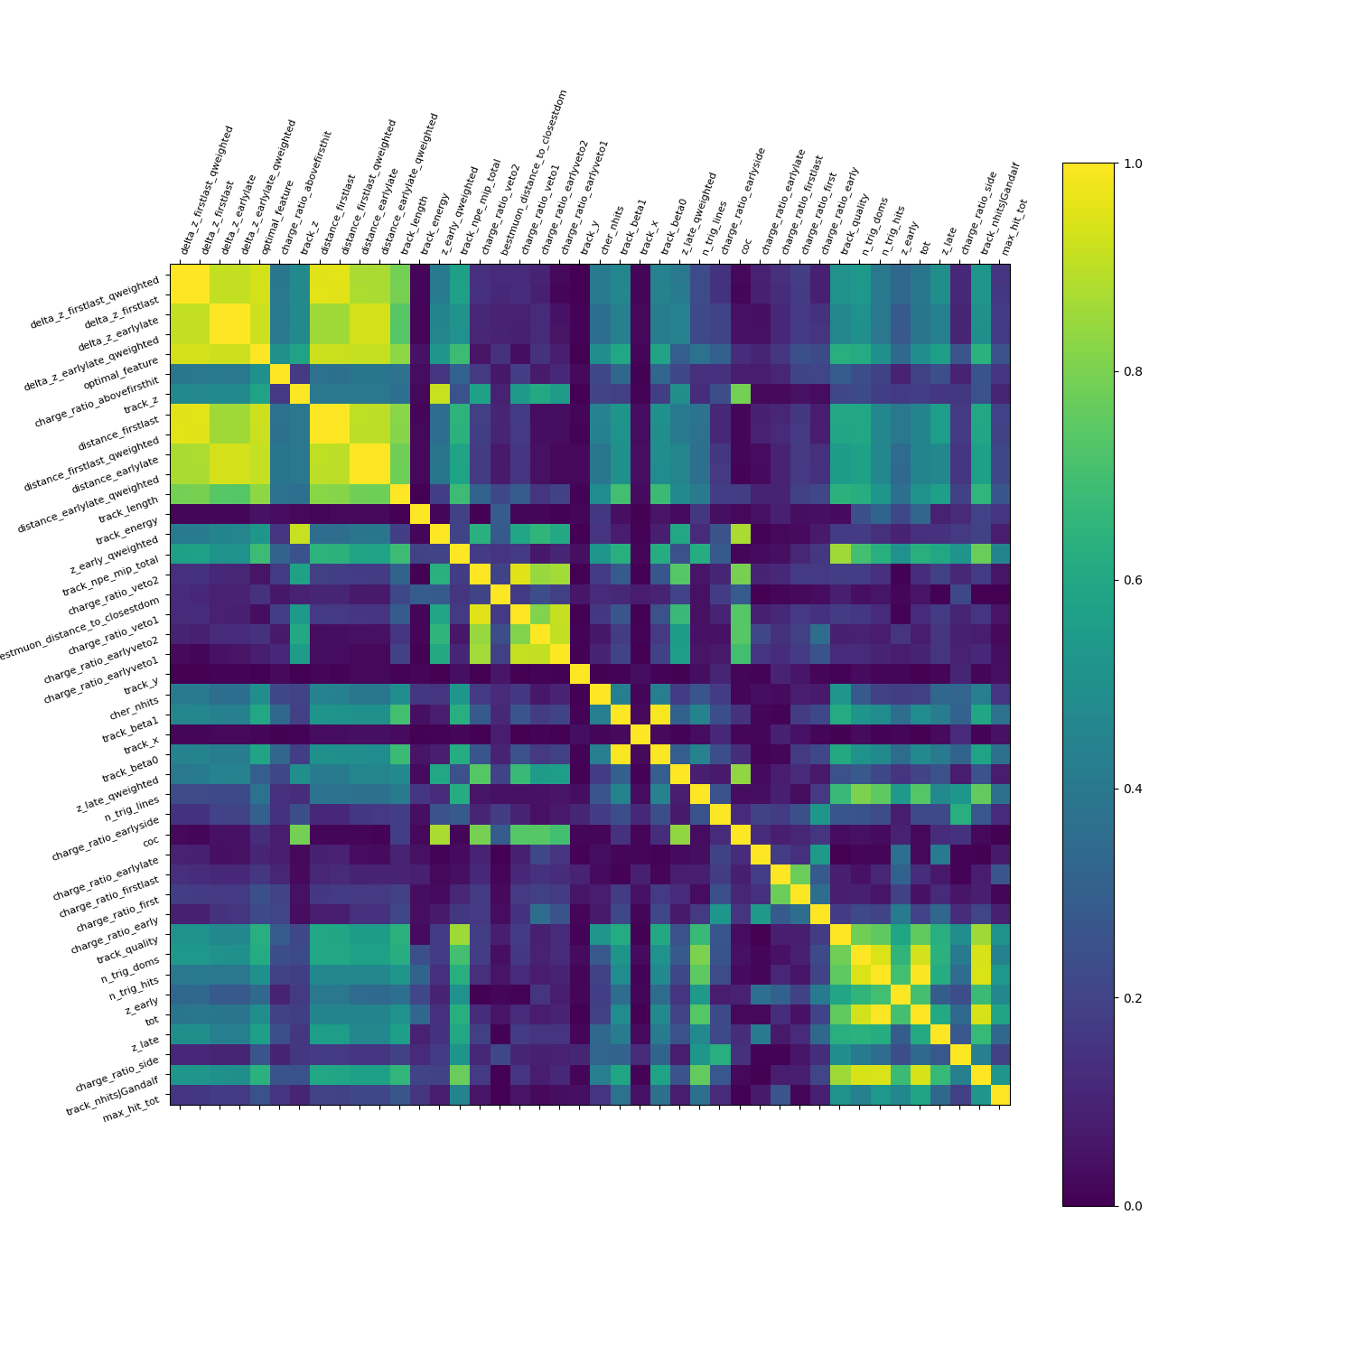
Method
Feature selection : Avoiding redundancy
Correlation matrix between features

Slide 15
What is next ?
Investigate what optimization metrics to use
Refining the feature selection
Choosing the model to train
Train the model and assess its efficiency

Slide 16
Questions

